Slide 1
Building Resilience: Preventing and Treating Compassion Fatigue
Jourdan Cruz, MSc, MSW, LICSW
Manager, Social Work and Patient Navigation
Fred Hutchinson Cancer Center
June 2023
Moving Beyond Cancer to Wellness June 2023
Notes:
Good morning!
I am Jourdan, and I will be presenting on the topics of Resilience and Compassion Fatigue. I know the title makes it sound like they are related. They are. But really, that colon should be more of a comma. If we build resilience intentionally, we might be able to withstand setbacks or address concerns we are currently experiencing.

Slide 2

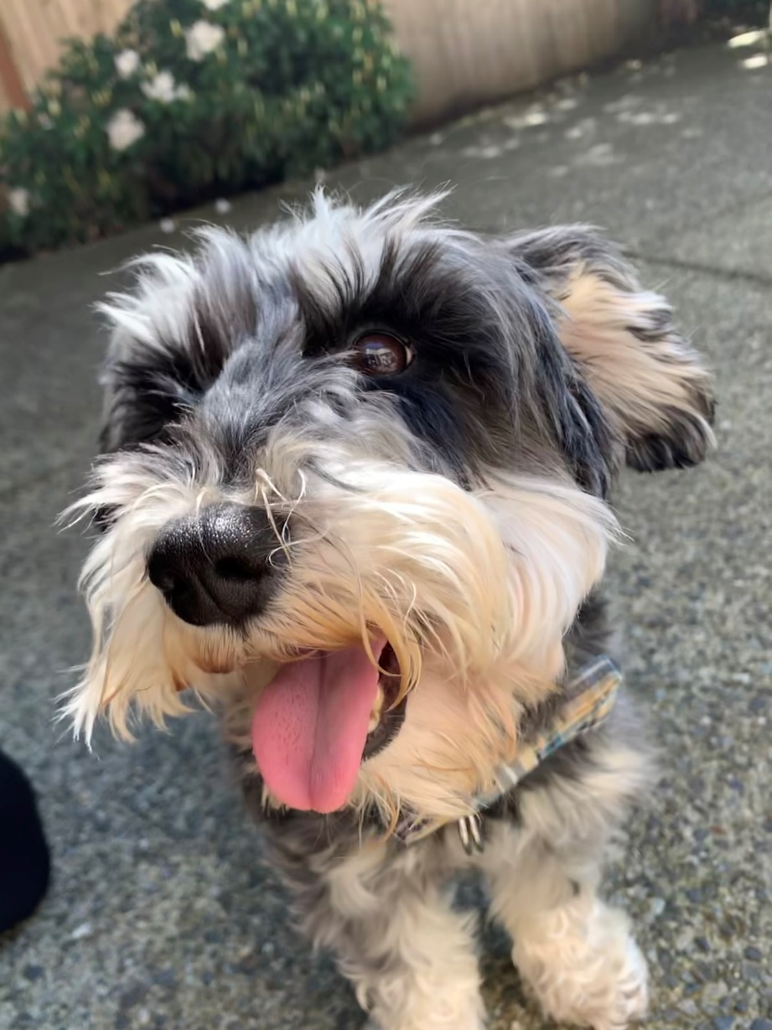

Three things to know
about me…
I love my dog, Bailey
I love my dog, Oliver
I love tacos
Bailey
Oliver
Moving Beyond Cancer to Wellness June 2023
Notes:
I am going to start with a little bit about my favorite subject: Me!
I love my dog, Bailey. I love my dog, Oliver. And I love tacos.
I am also the Manager of the social work and patient navigation teams here at Fred Hutch, and a co-leader on our Support Our Staff Team. Before I became a social worker, I studied compassion through a social psychology lens. Once. Now, I get to practice and teach it every day through clinical work.

Slide 3
1
Introductions (not me this time)
2
Defining and Fostering Resilience
3
Identifying and Addressing Compassion Fatigue
4
Discussion and Next Steps
5
Questions
Moving Beyond Cancer to Wellness June 2023
Notes:
We are going to start with introductions, don’t worry, it isn’t an ice breaker. Then we will talk about our two main concepts, resilience and compassion fatigue. Then we will have some time to discuss what this means for you, individually, and lastly, you can tell me how great I did.

Slide 4
Introductions
Your Name
How are you connected to Fred Hutch?
Moving Beyond Cancer to Wellness June 2023
Notes:
So, I will ask everyone to introduce themselves with their name and how they are connected to the Hutch? Are you a caregiver, patient, community member, staff? Maybe you walked in off the street looking for free stuff?

Slide 5
Resilience
“Hardships often prepare ordinary people for an extraordinary destiny.”
  C.S. Lewis
Moving Beyond Cancer to Wellness June 2023

Slide 6
Resilience is…
Definitions that you can trust!
“… a multidimensional construct that explains why people facing the consequences of adversity and stress can have a positive outcome, emphasizing adjustment to experiences that are perceived as threatening.”
1. Palacio G C, Krikorian A, Gómez-Romero MJ, Limonero JT. Resilience in Caregivers: A Systematic Review. Am J Hosp Palliat Care. 2020 Aug;37(8):648-658. doi: 10.1177/1049909119893977. Epub 2019 Dec 13. PMID: 31830813.
Moving Beyond Cancer to Wellness June 2023
Notes:
This mouthful of a definition is what happens when you let researchers dissect something that is equally simple and difficult.

Slide 7
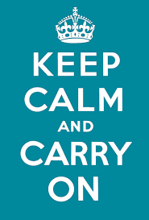

Resilience is…
Definitions that you can trust!
argue
“the art of getting up after being knocked down. It is the art of letting the world affect you and carrying on anyway.”
1. Palacio G C, Krikorian A, Gómez-Romero MJ, Limonero JT. Resilience in Caregivers: A Systematic Review. Am J Hosp Palliat Care. 2020 Aug;37(8):648-658. doi: 10.1177/1049909119893977. Epub 2019 Dec 13. PMID: 31830813.
Moving Beyond Cancer to Wellness June 2023
Notes:
This mouthful of a definition is what happens when you let researchers dissect something that is equally simple and difficult.

Slide 8
Resilience is NOT…
Three easy ways to be unhelpful
Get over it!
Ignore it!
Just deal with it!
Moving Beyond Cancer to Wellness June 2023

Slide 9
Resilience is…
Three helpful ways to reframe the idea of resilience
Adapt to it!
Address it!
Grow through it!
- Eileen McDargh
Moving Beyond Cancer to Wellness June 2023

Slide 10
Four Tools to Foster Resilience
Do what works, and what works is what you actually do
Accentuating the positive through cognitive reframing
  “Shift into Neutral”
  Countering cognitive distortions
Work Towards Acceptance
  “Practices makes for easier practice”
  Mindful walking, eating, and breathing practices
Moving Beyond Cancer to Wellness June 2023

Slide 11
Four Tools to Foster Resilience
Do what works, and what works is what you actually do
Schedule Pleasurable Activities
  “Elevation through Activation”
  Pick up a new hobby
Maintain Meaningful Social Connections
  Online, in-person, with pets, etc.
Moving Beyond Cancer to Wellness June 2023

Slide 12
Talk! But not all at once…
Moving Beyond Cancer to Wellness June 2023
Notes:
How do you talk to yourself?
What has gotten you through the last three+ years?
What helps?
What common piece of “advice” doesn’t help you?

Slide 13
Compassion Fatigue
“You may not personally be experiencing the trauma, you’re seeing it and you’re witnessing it. But your body doesn’t know that. It doesn’t know this isn’t my trauma.”
  Eleanor Wells
Moving Beyond Cancer to Wellness June 2023

Slide 14
Compassion Fatigue is…
“… a state experienced by those helping people or animals in distress; it is an extreme state of tension and preoccupation with the suffering of those being helped to the degree that it can create a secondary traumatic stress for the helper.”²
2. Figley C. The Compassion Fatigue Awareness Project. Available from: http://www.compassionfatigue.org/
Moving Beyond Cancer to Wellness June 2023

Slide 15
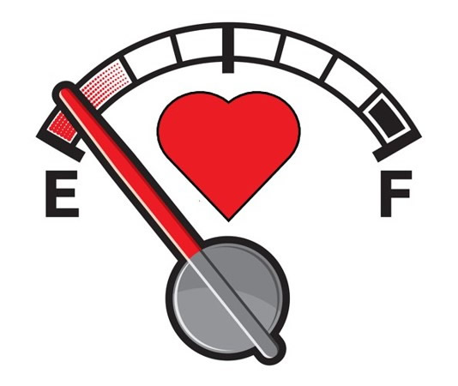
Compassion Fatigue is…
“… when we lose the ability to care for others effectively due to caring for others extendedly.”
2. Figley C. The Compassion Fatigue Awareness Project. Available from: http://www.compassionfatigue.org/
Moving Beyond Cancer to Wellness June 2023

Slide 16
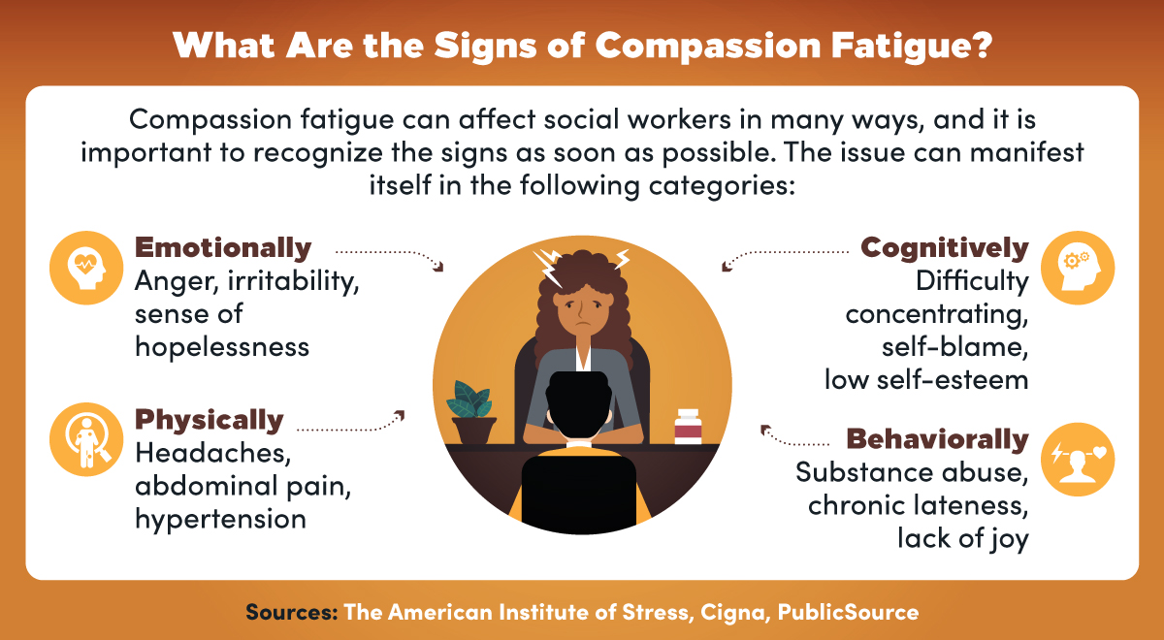
Moving Beyond Cancer to Wellness June 2023

Slide 17
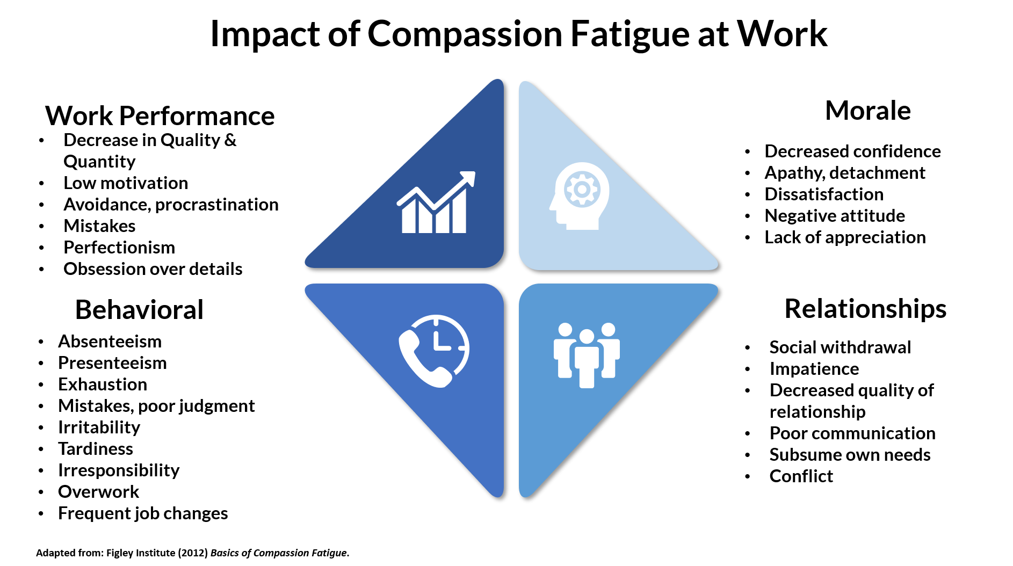
EVERYWHERE
Figley C. The Compassion Fatigue Awareness Project. Available from: http://www.compassionfatigue.org/
Moving Beyond Cancer to Wellness June 2023

Slide 18

Compassion Fatigue is…
Prevented by and treated with compassion!
Potentially not real (in a semantics, philosophical, and maybe neurological kind of way!)³
3. Dowling T. Compassion does not fatigue! Can Vet J. 2018 Jul;59(7):749-750. PMID: 30026620; PMCID: PMC6005077.
Moving Beyond Cancer to Wellness June 2023

Slide 19
How to avoid the thing that might be Compassion Fatigue
With a social experiment, some good new fashioned therapy techniques, and a bathtub full of self-care
Quick! What was I doing with my hands when I introduced myself? And what is something I shared that I loved?
  Remember the person, not their behavior
Perspective taking
  Something about shoes?
Humor as a de-stressing agent
  With, not at!
Moving Beyond Cancer to Wellness June 2023

Slide 20
How to address the thing that might be Compassion Fatigue
With a social experiment, some good new fashioned therapy techniques, and a truck load of self-care
Self-compassion is a start
  Worksheet and homework!
“Self-care is not a bubble bath” by Sharon Blue, MS, but they don’t hurt either
  Meaning creation, accepting help (professional or informal),
Boundaries, BOUNDARIES, BOUNDARIES
Moving Beyond Cancer to Wellness June 2023
Notes:
Repeat after me: Boundaries are healthy. Boundaries are necessary. Boundaries are self-care.

Slide 21
Talk, again!
Moving Beyond Cancer to Wellness June 2023
Notes:
What refills your cup? What gets in the way of refilling your cup? What is one thing you will do for yourself when you leave today?

Slide 22
Thank you
Moving Beyond Cancer to Wellness June 2023

